Slide 1

Final project Byron Washington

Slide 2


Background
I’ve been playing League of Legends for a while now
I play with bad players (my friends)
They ask: “Who is good”
I will answer that
Stop Dying

Slide 3




Objectives
We want to find a handful of champions that are in the best roles and are easy to pick up.
To do this we’re looking for a few things:
Win Rate
Ban Rate
Champion Difficulty
Average KDA (Kills/Deaths/Assists)
Role Win Rate
Role Difficulty
Resource Types
Top 2% of Players

Slide 4
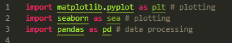
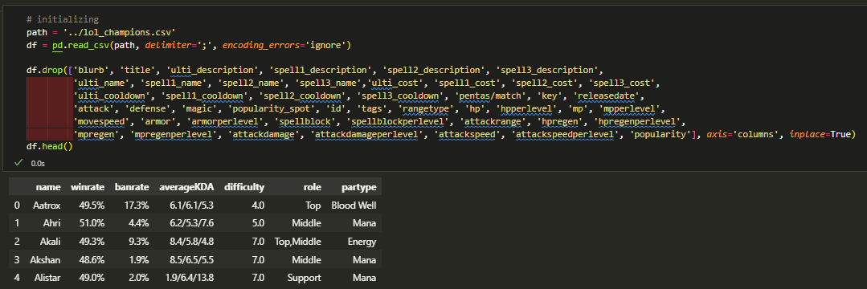
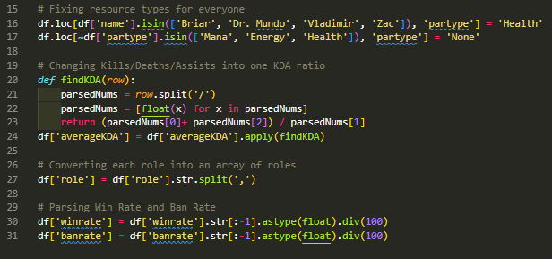
Cleaning the Data
Importing packages and dataset
Dropping columns that aren’t needed
Looking at the table, most of the formatted data doesn’t look right so I had to clean a few things:
Fixing the resource types
Changing “averageKDA” to be one ratio
Converting ‘role’ into an array of roles
Parsing “winrate” and “banrate”

Slide 5
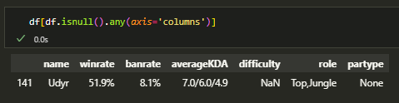
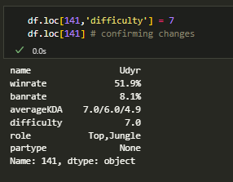
Null Values
The only null row was with Udyr, so I had to manually enter his difficulty

Slide 6

Results
Now that the data has been cleaned, we can look for the right champions to answer our question

Slide 7
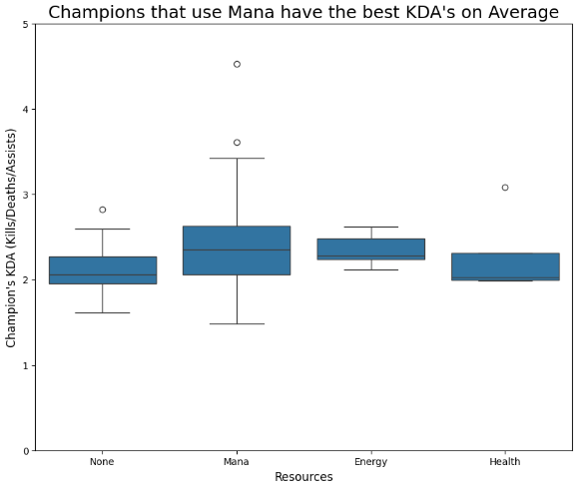
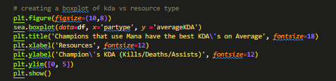
KDA vs Champion Resource

Slide 8

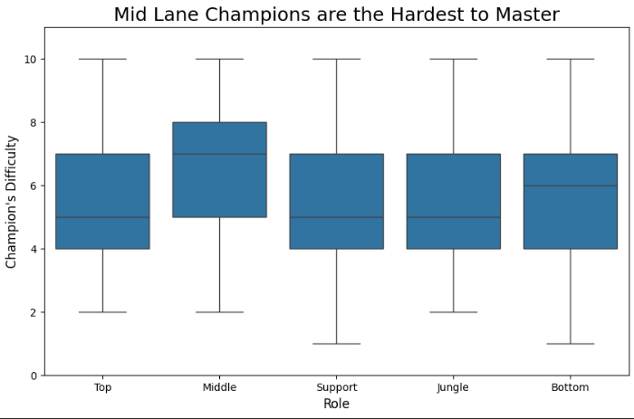
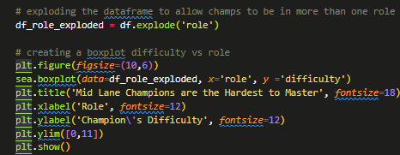
Difficulty vs Role

Slide 9
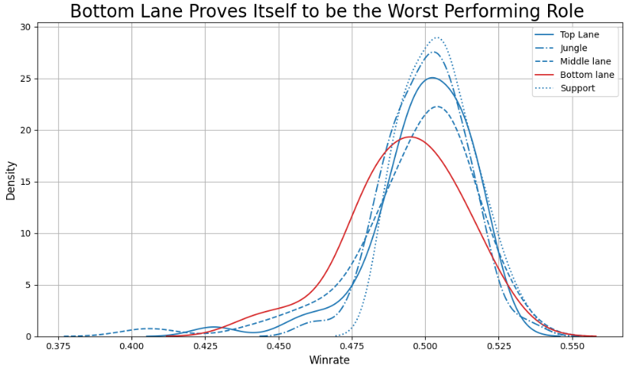
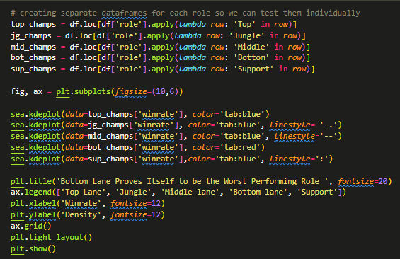
Winrates Per Role

Slide 10
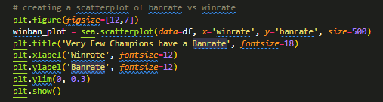
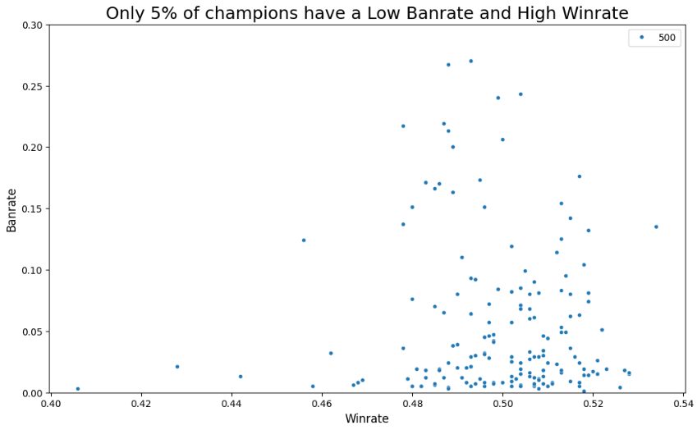
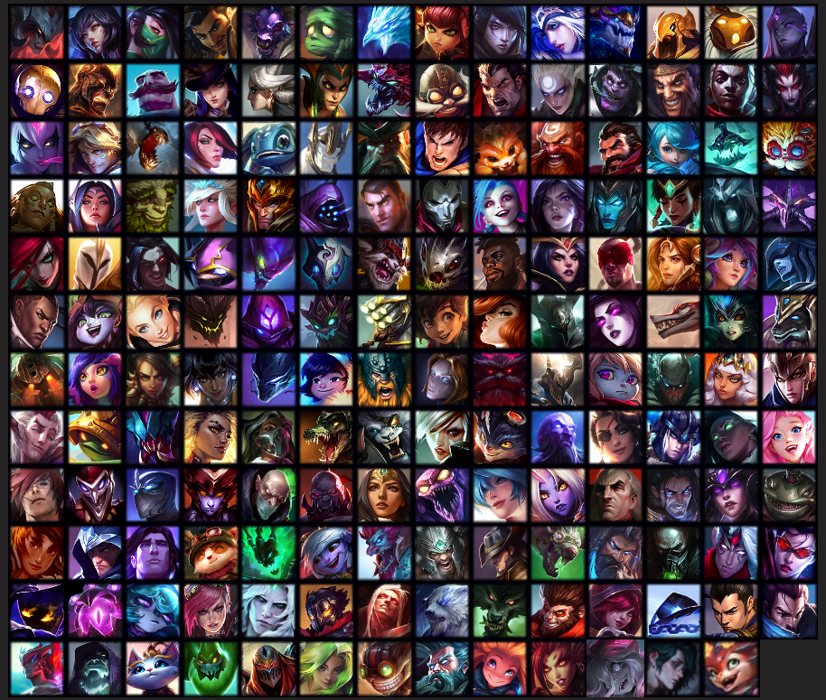
Winrate vs Banrate per Champion
167 Champions to choose from

Slide 11
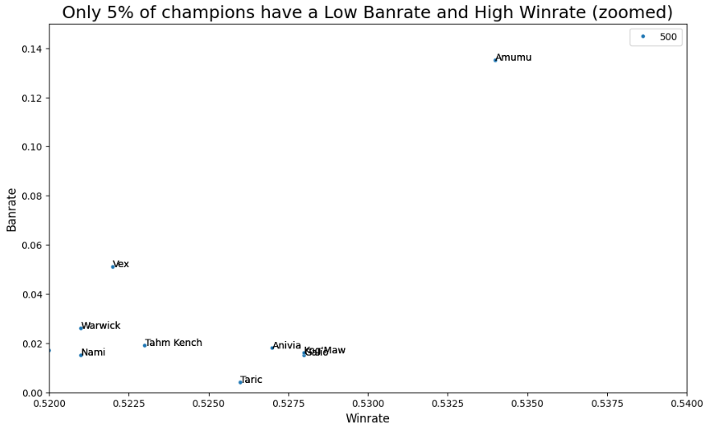
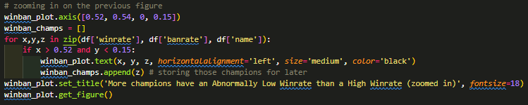









Winrate vs Banrate per Champion
Now we have 9 champions to choose from.

Slide 12

Conclusion

Slide 13
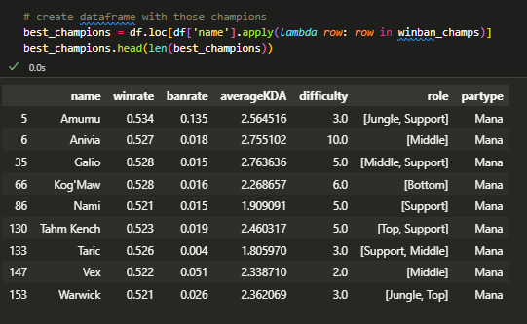
Now that we have 9 champions to choose from, we can start filtering out the ones without the properties we like.

Slide 14
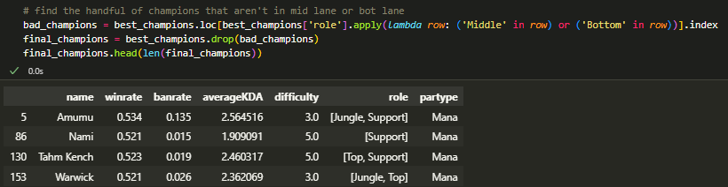
After filtering out the bad properties, we’re now left with 4 champions that you can choose from to help with your climb in League of Legends

Slide 15

Thank you

